Slide 1

Jain institute of technology
Computer science and engineering
Internship project on
Web Designing-”Sambrham Event Management”
Under the guidance of
Mr. Janardhan C N
Assistant Professor
Department of CS&E
Project By
Pavan Kumar T P 4JD15CS026
Pradeep C S 4JD15CS030
Prasanna N 4JD15CS031
Praveesh B R 4JD15CS032

Slide 2

ORGANIZATIONAL PROFILE
Sookshma Chetas Softwares Pvt. Ltd. is Software Company with a common goal of innovative and
creative ideas and software solutions in the information technology industry and it is started in 2012.
The services provided by Sookshma Chetas are Web Design and Development, E-commerce Web
Development, Mobile Applications, Software Development, Search Engine Optimization and Responsive
designs.
All operations of the company managed are under the intellectual guiding principles of honourable Director, Mr. Kamlesh.

Slide 3
INTRODUCTION
Web programming, also known as web development, is the creation of dynamic web applications.
There are two broad divisions of web development – front-end development (also called client-side development) and back-end development (also called server-side development)
Sambrham events is event management service providing website.
It offers various services according to the customer budget.
It provides services for wedding ,house warming ,baby naming ,corporate functions, birthday parties.
Admin login is provided for managing various customer needs.
Admin will view the requirements ,makes the pricing and estimated invoice is sent to the customer.

Slide 4
TECHNOLOGIES USED TO DEVELOP EVENT MANAGEMENT WEBSITE
HTML:
Hypertext Mark-up Language is the standard mark-up for creating web pages and web applications.
CSS:
Cascaded style sheets are used to display html elements effectively which includes style rules.
Bootstrap:
It is a framework to help you to design websites faster and easier.
Typography ,forms ,buttons ,tables ,navigations,dropdowns ,alerts,tabs, carousels are available in Bootstrap

Slide 5
Contd..
Java script
It is a high level ,object oriented scripting language used to make interactive web pages.
Angular JS
It is open source structural frame work which is similar to JS. It supports data binding and dependency injection.
Mongo DB
It is a based on NoSQL document store model. Data objects are stored as separate documents inside a collection instead of storing as rows and columns.

Slide 6
System Requirements
Hardware Requirements:
Processor: i3 or higher
RAM: min of 4gb
HDD: min of 200gb
Software Requirements:
Front end: HTML,CSS,Bootstrap
Scripting: Javascript,Angular JS,Jquery
Middle ware: Node. JS
Back end: Mongo DB
OS: Widows 7 or higher

Slide 7
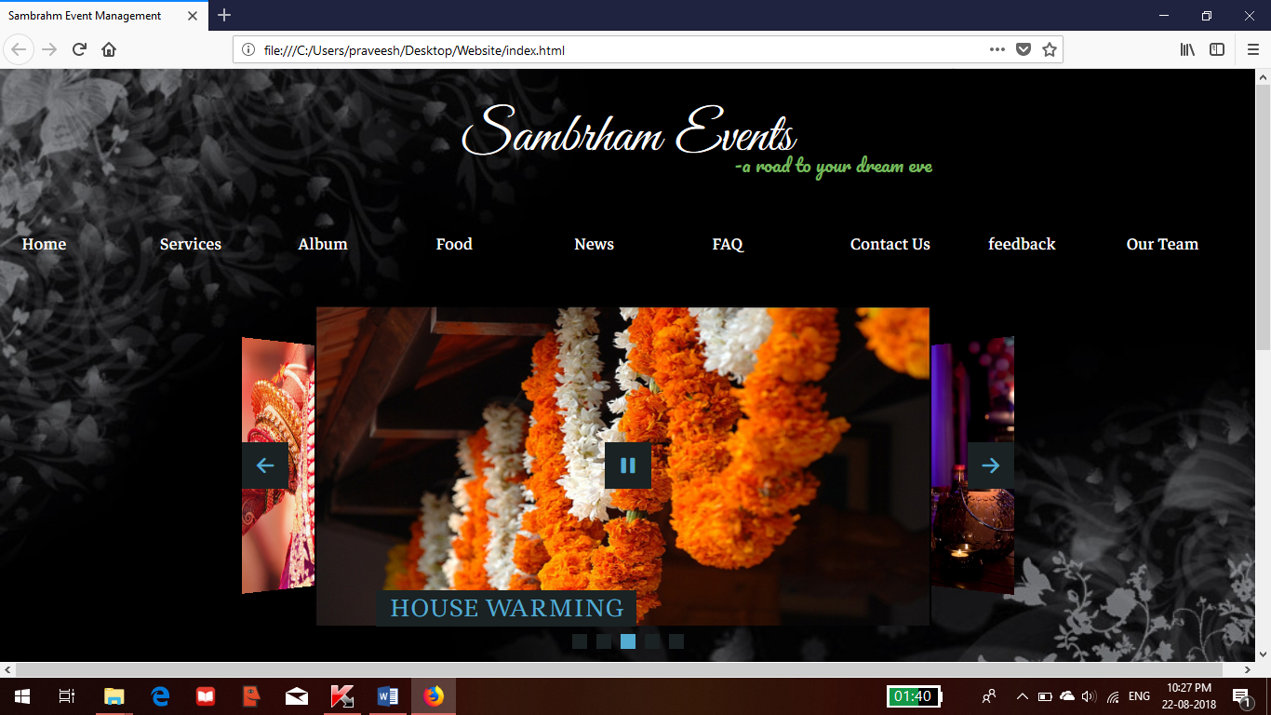
Home page
SNAP SHOTS
The users can view the various services offered by Sambrham and can view the testimonials in home page.

Slide 8
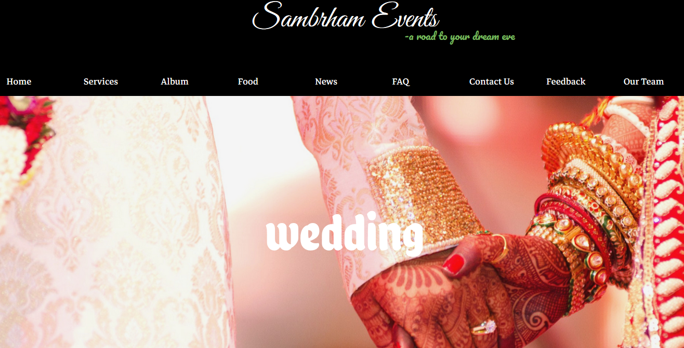
Wedding service page
This is wedding service page ,users can view our previous design and can view the available halls in this page.

Slide 9
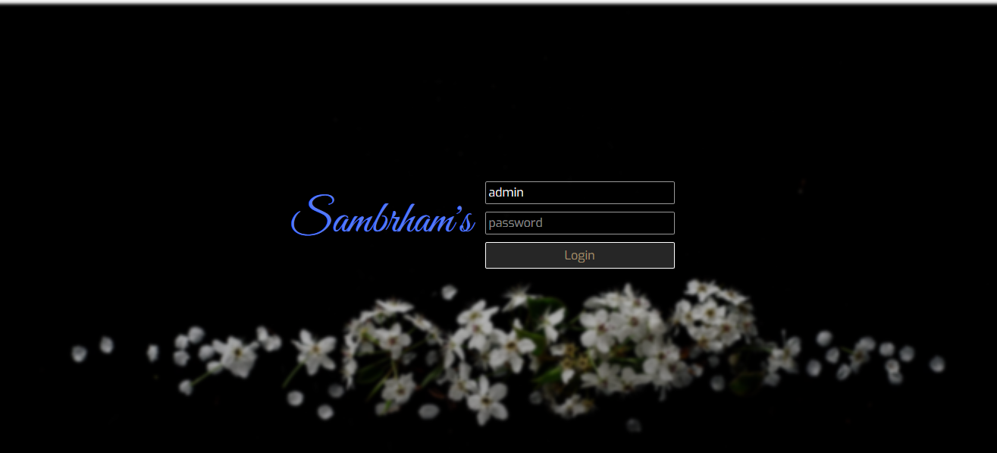
Admin log in page
This is the admin log in page where he/she can log in by providing login name and password.

Slide 10

Admin home page
Admin can see various customers requirements , feedbacks and can update party halls.

Slide 11
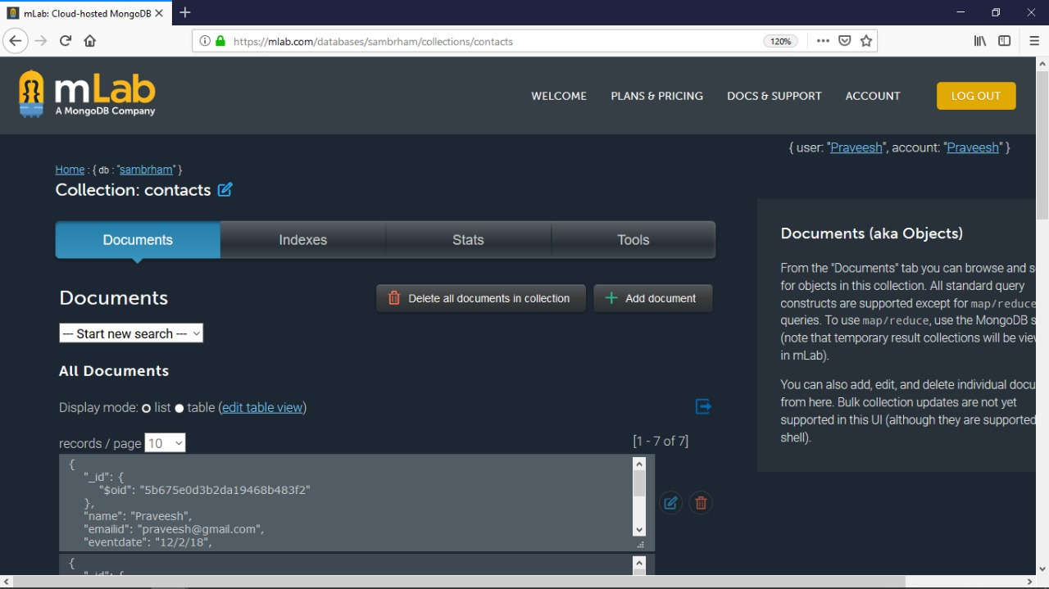
Snap shot of data stored in backend
All the feedbacks and customer requirements are stored in mLab mongo DB as a json format.

Slide 12
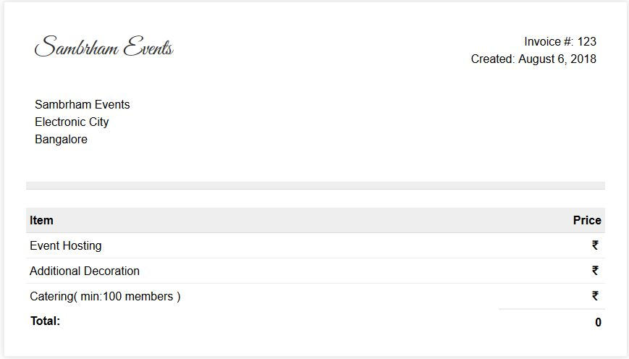
Snapshot of estimated invoice
Admin will email the estimated invoice to the customer based on their requirements.

Slide 13
CONCLUSION
Sambrham Event Management provides services according to the customer needs.
Customers can get effective designs based on their budget.
It is user friendly and effective maintenance makes it more efficient.
Admin can manage multiple requests without much paper work.

Slide 14


